Slide 1
Object Oriented Programming Lab #09 Association, Aggregation and Composition in Java
ENGR. SANIYA SARIM

Slide 2
Association
In Object-oriented programming, one object is related to other to use functionality and service provided by that object. This relationship between two objects is known as the association.
Association refers to the relationship between multiple objects. It refers to how objects are related to each other and how they are using each other's functionality. Composition and aggregation are two types of association.

Slide 3
Composition
The composition is the strong type of association. An association is said to composition if an Object owns another object and another object cannot exist without the owner object. Consider the case of Human having a heart. Here Human object contains the heart and heart cannot exist without Human.

Slide 4
Composition Example
We refer association between two objects as Composition, when one class owns other class and other class can not meaningfully exist, when it's owner destroyed, for example, Human class is a composition of several body parts including Hand, Leg and Heart. When human object dies, all it's body part ceased to exist meaningfully, this is one example of Composition.
Another example of Composition is Car and it's part e.g. engines, wheels etc. Individual parts of the car can not function when a car is destroyed.

Slide 5
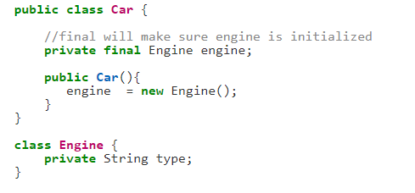
Composition Example
Composition : Since Engine is-part-of Car, the relationship between them is Composition. Here is how they are implemented between Java classes.

Slide 6
Aggregation
Aggregation is a weak association. An association is said to be aggregation if both Objects can exist independently. For example, a Team object and a Player object. The team contains multiple players but a player can exist without a team.
Another example of Aggregation is Student in School class, when School closed, Student still exist and then can join another School or so.

Slide 7
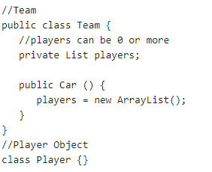
Aggregation Example
Aggregation : Since Organization has Person as employees, the relationship between them is Aggregation. Here is how they look like in terms of Java classes

Slide 8
Association Exercise
Note:
Association is relation between two separate classes which establishes through their Objects. Association can be one-to-one, one-to-many, many-to-one, many-to-many.
Show the relation between bank and employees using the concept of association.

Slide 9
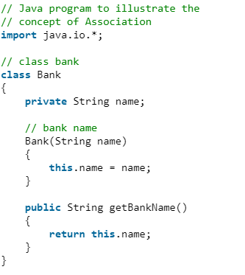
Association Exercise Solution

Slide 10
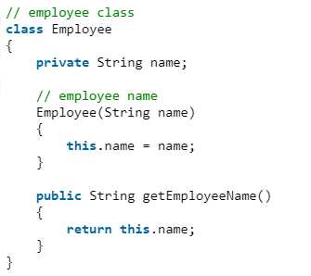
Association Exercise Solution cont..

Slide 11
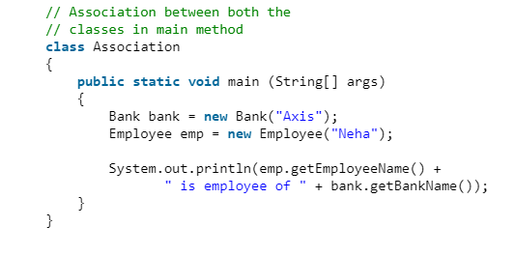
Association Exercise Solution cont..

Slide 12

Output

Slide 13
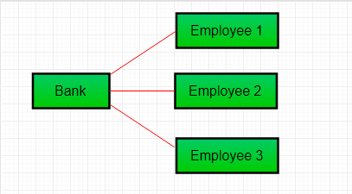
One-to Many Association
In above example two separate classes Bank and Employee are associated through their Objects. Bank can have many employees, So it is a one-to-many relationship.

Slide 14
Aggregation Exercise
Implement a university scenario comprising of students, departments and institute as classes using the concept of aggregation.

Slide 15
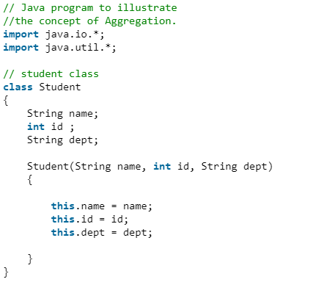
Student Class

Slide 16
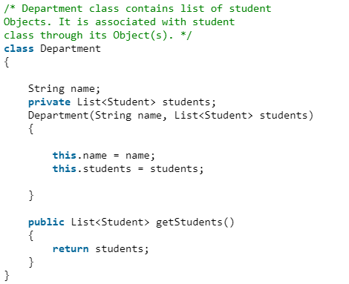
Department Class

Slide 17
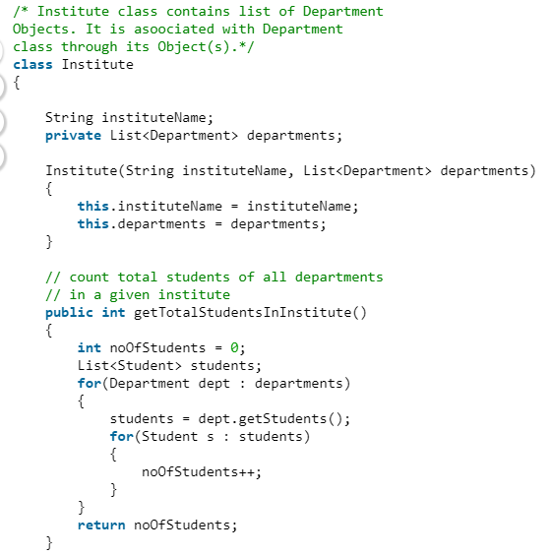
Institute Class

Slide 18
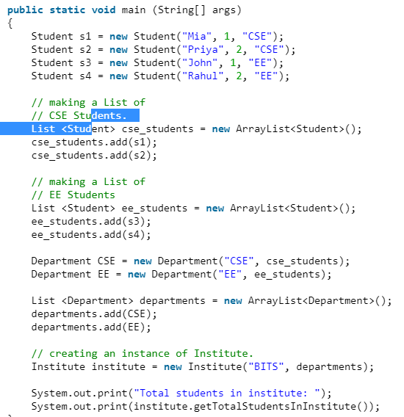
Main Method

Slide 19

Output

Slide 20
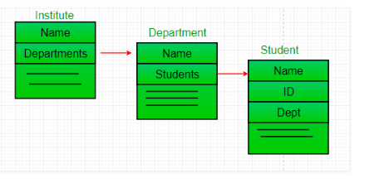
Aggregation
It is a special form of Association where:
It represents Has-A relationship.
It is a unidirectional association i.e. a one way relationship. For example, department can have students but vice versa is not possible and thus unidirectional in nature.
In Aggregation, both the entries can survive individually which means ending one entity will not effect the other entity

Slide 21
Composition Exercise
Implement the Library and books scenario using the concept of Composition.

Slide 22
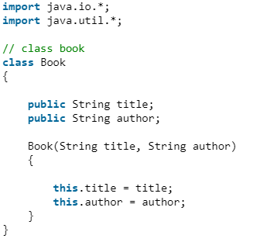
Book Class

Slide 23
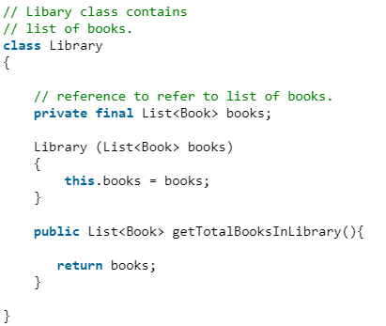
Library Class

Slide 24
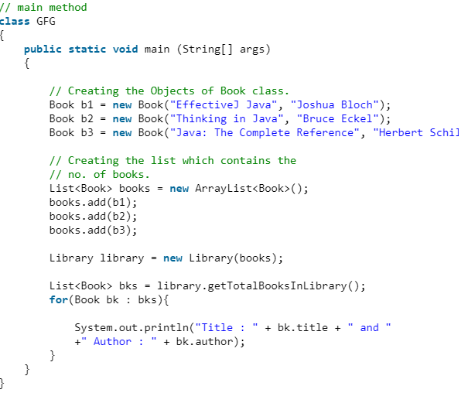
Main Method

Slide 25

Output

Slide 26
Composition
In above example a library can have no. of books on same or different subjects. So, If Library gets destroyed then All books within that particular library will be destroyed. i.e. book can not exist without library. That’s why it is composition.
Composition is a restricted form of Aggregation in which two entities are highly dependent on each other.
It represents part-of relationship.
In composition, both the entities are dependent on each other.
When there is a composition between two entities, the composed object cannot exist without the other entity.

Slide 27
Aggregation Vs Composition
Dependency: Aggregation implies a relationship where the child can exist independently of the parent. For example, Bank and Employee, delete the Bank and the Employee still exist. whereas Composition implies a relationship where the child cannot exist independent of the parent. Example: Human and heart, heart don’t exist separate to a Human
Type of Relationship: Aggregation relation is “has-a” and composition is “part-of” relation.
Type of association: Composition is a strong Association whereas Aggregation is a weak Association.

